Slide 1
Objectives
In this session, you will:
  Understand the importance of correct usage of grammar
  Identify common errors while writing
  Identify best practices of effective writing
  Understand the guidelines for writing effective e‑mails and appreciate the e-mail etiquettes
  Understand the importance and types of business writing
  Appreciate and use five C’s of effective writing

Slide 2
Importance of Correct Usage of Grammar
Grammar is a set of rules that govern correct and perfect writing.
Consider the following aspects of grammar for effective writing:
  Subject-verb agreement
  Sentence construction
  Active-passive voice
  Punctuation
Notes:
SG Notes:
In a working environment, you may be required to write letters or e-mails. The effectiveness of written communication is rooted in grammar. Grammar is a set of rules that govern correct and perfect writing. By adhering to the rules of grammar, you can ensure that the document contains the intended meaning.

Slide 3
Subject-Verb Agreement
To ensure subject-verb agreement, check that:
  A singular subject acquires a singular verb.
  A plural subject acquires a plural verb.
  The verb agrees with the main subject.
  The verb agrees with the indefinite pronoun.

Slide 4
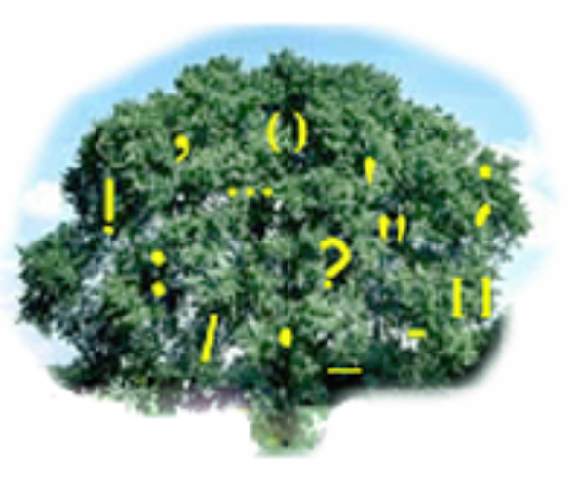
Punctuation
Punctuation:
  Includes all the marks used within or after the sentences.
  Clarifies the meaning of the sentences.

Slide 5
Sentence Construction
To ensure correctness in sentence construction, check that the sentences are:
  Free from grammatical errors
  Not disjointed
  Not fragmented

Slide 6
Active-Passive Voice
Active voice:
  Directly links the subject.
Passive voice:
  Indirectly links the subject.
The dog bit the girl.
Deepti will present her report at the meeting.
The girl was bitten by the dog.
Report will be presented by Deepti at the meeting.

Slide 7


Common Mistakes in Effective Writing
The common mistakes in effective writing are:
  I syndrome
  Wrong capitalization
  Spelling mistakes
  Long sentences
  Wrong ordering

Slide 8

Best Practices of Effective Writing
Use positive and effective words/statements to:
  Make the reader feel motivated, appreciated, and valued.
  Inform the negative information in a positive manner.
  Increase the confidence level of the reader.
  Reduce negative emotions and experience positive emotions.

Slide 9






















Activity: Positive Statements
In this activity, you will write positive statements.

Slide 10




E-mail Writing
E-mail is a form of electronic communication.
An e-mail consists of:
  Header
  Body

Slide 11
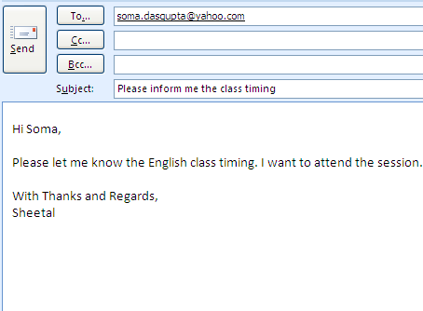
E-mail Writing (Contd.)
Header – It contains the following fields:
  To
  Cc
  Bcc
  Subject
Body – It is divided into:
  Opening
  Detailing
  Closing

Slide 12
Guidelines for E-mail Writing
Guidelines for writing business e-mails are:
  Use an appropriate subject line.
  Use an appropriate greeting.
  Keep the message short and simple.
  Quote accurate data/facts.
  Use business English.
  Use standard font and colour.
  Proofread and check spellings before sending.

Slide 13
E-mail Etiquettes
Follow the e-mail etiquette for writing an effective
e-mail:
  Always read the complete e-mail before framing your reply.
  Write short sentences.
  Ensure that the grammar is correct.
  Keep the language simple and professional.
  Be accurate while providing information.
  Avoid spelling mistakes.
  Provide a subject that summarizes the content of the entire mail.
  Maintain a positive tone.
  Introduce yourself and provide a proper sign-off.
  Check the size of the attachments before sending.

Slide 14
Activity: Writing an E-mail
Write e-mails for the following situation:
  To the HR department of your organization, asking for information regarding your annual benefits and insurance.
  To your subordinate, asking him/her to send you the market analysis document urgently.
  To a client, sending a brochure of a new product and requesting him/her to purchase.

Slide 15
Importance and Types of Business Writing
Business writing is referred as the written communication created for a business audience.
Business writing requires a crisp, precise, and focused approach.
Business writing is commonly used while creating:
  Reports
  Brochures
  Memos
  Questionnaires
  Surveys
  Letters
  E-mails

Slide 16
Report
A report can be defined as a document that is created to explain the result of a query.
A report contains:
  Title page
  Executive summary/abstract
  Table of contents
  Introduction
  Body
  Conclusion
  Reference list
  Appendix

Slide 17
Brochure
A brochure or pamphlet is a paper used for advertisement.
Brochures are used for introducing a product or service.
Common brochure styles are:
  Single sheet
  Booklet forms

Slide 18
Memo
Memo:
  Is a form of written communication within an organization.
  Should be short and to-the-point.
  Does not have a salutation or complimentary closing.
  Has a specific format.
Memo
* Date ________
* To _________
* From _______________
* Subject _______________
* Text __________________
______________________
______________________

Slide 19

Questionnaire
Questionnaires are used to collect responses from people.
The responses collected are used for analysis.
A questionnaire can be:
  Subjective
  Objective

Slide 20
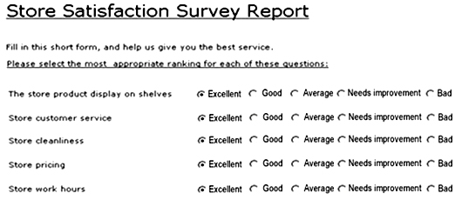
Survey
Survey is a method of gathering information to get the opinion of individuals on certain topics.

Slide 21
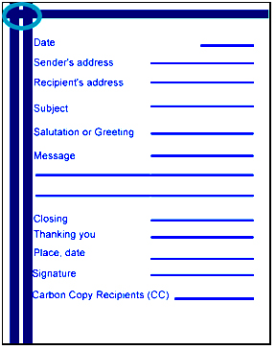
Letter
Letters are used for formal correspondence.

Slide 22
Five C’s of Effective Writing
The following writing principles makes your business writing effective:
  Clarity
  Conciseness
  Cohesion
  Consistency
  Correctness

Slide 23
Summary
In this session, you learned that:
  Aspects of grammar that are most relevant for effective writing are:
    Subject-verb agreement
    Punctuation
    Sentence construction
    Active and passive voice
  Common mistakes made in effective writing are:
    I syndrome
    Wrong capitalization
    Spelling mistakes
    Long sentences
    Wrong ordering

Slide 24
Summary (Contd.)
  Use positive and effective words to make writing effective.
  E-mail is a form of electronic communication. E-mail consists of two parts, the header and the body.
  Guidelines for writing business e-mails are:
    Use an appropriate subject line.
    Use an appropriate greeting.
    Keep the message short and simple.
    Quote accurate data/facts.
    Use business English.
    Use standard font and color.
    Proofread and check spellings before sending the e-mail.
  Adhere to the e-mail etiquette for writing effective business
  e-mails.

Slide 25
Summary (Contd.)
  Business writing is referred to the written communication created for a business audience.
  Business writing requires a crisp, precise, and focused approach.
  Business writing is commonly used while creating:
    Reports
    Brochures
    Memos
    Questionnaires
    Surveys
    Letters

Slide 26
Summary (Contd.)
  The following writing principles will help you to make your business writing effective:
    Clarity
    Conciseness
    Cohesion
    Consistency
    Correctness

